Slide 1
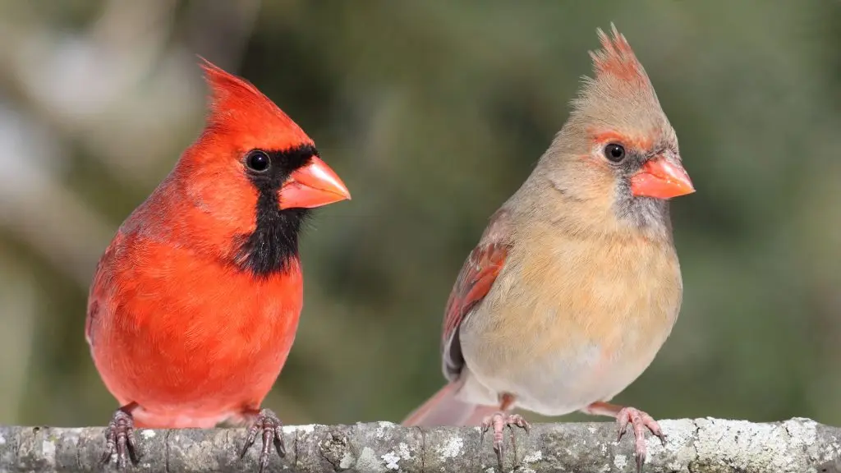
Verónica A. Rincón-Rubio, Rosana Zenil-Ferguson, Alejandro Gonzalez-Voyer. 2025. “The macroevolutionary consequences of the association between frugivory and carotenoid-dependent plumage coloration in passerine birds” Evolution, 2025, 79(8), 1643–1657 https://doi.org/10.1093/evolut/qpaf105
Class focus area: SSE and correlation
EEB603: Brian O’Meara
All quotes and images from the above paper unless otherwise noted
Photo from https://www.birdadvisors.com/northern-cardinal/

Slide 2
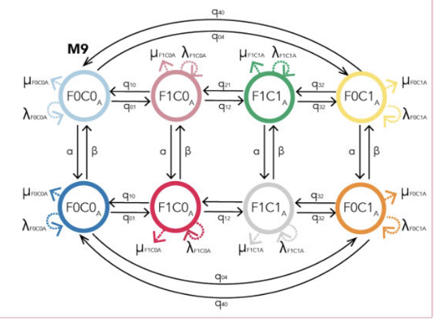
Well, this seems easy…

Slide 3
0
2
1
Notes:
Move from state to state

Slide 4
A, T, G, C
woody, herbaceous
susceptible, infected, recovered
herbivorous, omnivorous, carnivorous
0, 2, 4, 6, 8, ..., 100 legs
Notes:
finite

Slide 5
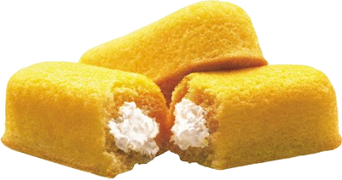
Per day:
Action | Bought by adult | Bought by child | Stolen
Probability | 0.20 | 0.10 | 0.05
What is probability of it leaving the store that day?
If it leaves, what is the probability it was paid for?
What is the probability it stays in the store ≥ two days?
Notes:
Note it can’t be bought by adult and by child same day. use twinkies as they can last forever until something happens

Slide 6
Per ∆t:
Action | Bought by adult | Bought by child | Stolen
Probability | 0.20 /scaling | 0.10 /scaling | 0.05 /scaling

Slide 7
Per ∆t:
Action | Bought by adult | Bought by child | Stolen
Rate | radult | rchild | rstolen

Slide 8
Per ∆t:
From \ To | Store | Adult | Child | Thief
Store | - | rstore-adult | rstore-child | rstore-thief

Slide 9
Per ∆t:
From \ To | Store | Adult | Child | Thief
Store | - | rstore-adult | rstore-child | rstore-thief
Adult
Child
Thief

Slide 10
Per ∆t:
From \ To | Store | Adult | Child | Thief
Store | - | rstore-adult | rstore-child | rstore-thief
Adult | radult-store | - | radult-child | radult-thief
Child | rchild-store | rchild-adult | - | rchild-thief
Thief | rthief-store | rthief-adult | rthief-child | -

Slide 11
From \ To | Store | Adult | Child | Thief
Store | - | rstore-adult | rstore-child | rstore-thief
Adult | radult-store | - | radult-child | radult-thief
Child | rchild-store | rchild-adult | - | rchild-thief
Thief | rthief-store | rthief-adult | rthief-child | -
From \ To | Store | Adult | Child | Thief
Store | - | rstore-adult | rstore-child | rstore-thief
Adult | radult-store | - | radult-child | radult-thief
Child | rchild-store | rchild-adult | - | rchild-thief
Thief | rthief-store | rthief-adult | rthief-child | -
Does the store ever get Twinkies back?
[Do people return Twinkies for a refund?]
H0: r*-store = 0
H1: r*-store > 0
Notes:
Is a rate truly 0? What does it mean to test this? What about testing whether herbicide use affects frog reproduction,

Slide 12
From \ To | Store | Adult | Child | Thief
Store | - | rstore-adult | rstore-child | rstore-thief
Adult | radult-store | - | radult-child | radult-thief
Child | rchild-store | rchild-adult | - | rchild-thief
Thief | rthief-store | rthief-adult | rthief-child | -
Do adults give to kids at the same rate kids give to adults?
H0: rchild-adult = radult-child
H1: rchild-adult ≠ radult-child
Notes:
Do we really think any rates are exactly equal?

Slide 13
From \ To | Store | Adult | Child | Thief
Store | - | rstore-adult | rstore-child | rstore-thief
Adult | radult-store | - | radult-child | radult-thief
Child | rchild-store | rchild-adult | - | rchild-thief
Thief | rthief-store | rthief-adult | rthief-child | -
Store
Adult
Thief
Child
Notes:
Do we really think any rates are exactly equal?

Slide 14
Store
Adult
Thief
Child
Notes:
Do we really think any rates are exactly equal?

Slide 15
Making more twinkies
Store
Adult
Thief
Child
Notes:
Do we really think any rates are exactly equal?

Slide 16
Making more twinkies
Store
Adult
Thief
Child
Eating twinkies
Notes:
Do we really think any rates are exactly equal?

Slide 17
Trait only, assumes zero differential effect on birth or death
Making more twinkies
Trait plus birth-death model
Store
Adult
Store
Adult
Thief
Child
Thief
Child
Eating twinkies
Notes:
Do we really think any rates are exactly equal?

Slide 18
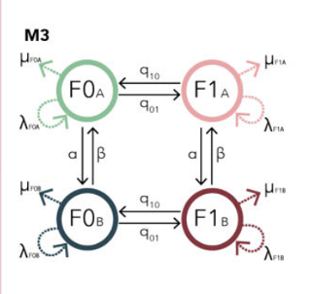
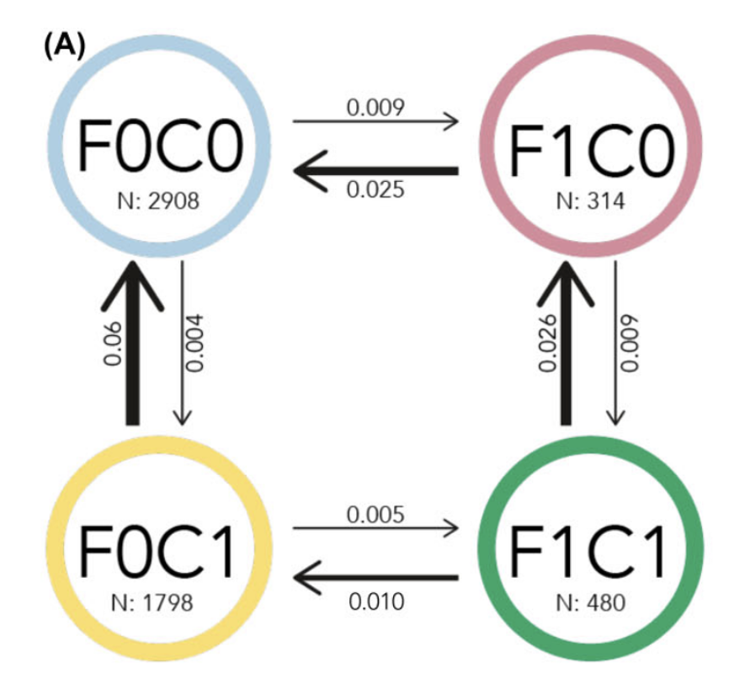
Trait only, assumes zero differential effect on birth or death
Making more twinkies
Trait plus birth-death model
Store
Adult
Store
Adult
Thief
Child
Thief
Child
Eating twinkies
BayesTraits
RevBayes
Notes:
Do we really think any rates are exactly equal?

Slide 19
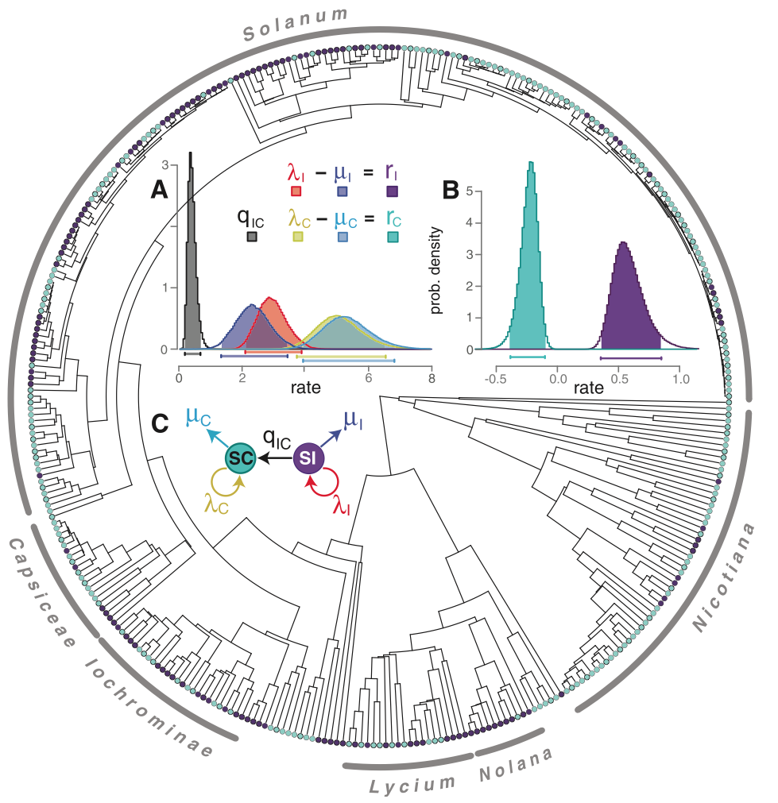
Goldberg et al. 2010

Slide 20
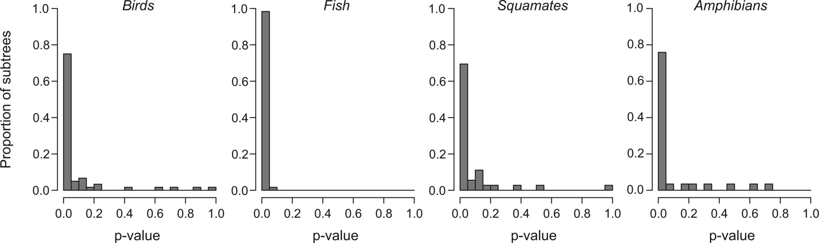
In the second exercise, we analyzed the effect of a purely arbitrary character on speciation rates across the 200–500 taxon subtrees drawn from the four vertebrate clades described above. We tested whether taxon name length—the number of letters in the Latin binominal for each taxon—was associated with speciation rate. We counted the number of letters in each taxon name and scored each species as “short” or “long” depending on whether the taxon name length was less than or greater than the median name length for taxa in each subtree. This character exhibits some phylogenetic signal as would an evolving trait, owing to the correlation in name lengths between congeners. For example, within the 60 bird subtrees, we found that 44 trees (73%) showed significant (p<0.05⁠⁠) phylogenetic signal in taxon name length, as assessed by computing the K-statistic (Blomberg et al. 2003) for each data set and determining significance via tip randomization. Name length of course cannot plausibly be considered a driver of speciation, although species richness could be reflected in linguistic or taxonomic practices. We fitted the four- and five-parameter BiSSE models described above to each subtree.
Rabosky & Goldberg 2015

Slide 21
Notes:
So, for example, if you have a clade where some species have orange flowers and others blue flowers, you can fit a BiSSE model that allows speciation and extinction to vary in function of flower color. You can then estimate the parameters of speciation, extinction and transition between flower colors that maximize the likelihood of observing that particular tree and species with particular flower colors at the tips. And then you can say that, for example, orange flowers have a higher speciation rate than blue flower and use this information in the context of your biological narrative.
OK

Slide 22
💀
💀
Notes:
So, for example, if you have a clade where some species have orange flowers and others blue flowers, you can fit a BiSSE model that allows speciation and extinction to vary in function of flower color. You can then estimate the parameters of speciation, extinction and transition between flower colors that maximize the likelihood of observing that particular tree and species with particular flower colors at the tips. And then you can say that, for example, orange flowers have a higher speciation rate than blue flower and use this information in the context of your biological narrative.
OK

Slide 23
💀
💀
λ_{blue} < λ_{orange}
Notes:
So, for example, if you have a clade where some species have orange flowers and others blue flowers, you can fit a BiSSE model that allows speciation and extinction to vary in function of flower color. You can then estimate the parameters of speciation, extinction and transition between flower colors that maximize the likelihood of observing that particular tree and species with particular flower colors at the tips. And then you can say that, for example, orange flowers have a higher speciation rate than blue flower and use this information in the context of your biological narrative.
OK

Slide 24
Pink ornaments
💀
💀
💀
Notes:
However, as the field evolved, these simple SSE models proved to be problematic for several reasons. One of these problems was that simple SSE models would often force all the variation in speciation and extinction rates to be associated with the different character states of the trait under analysis, even when that particular trait had a neutral effect on the diversification of the group.
In this case, for example, perhaps flower color was not really the trait that best correlate with differences in diversification dynamics in the clade, but these are instead best explained by some other characteristic like pink ornaments that appear more often in orange flowers. Even so, a simple BISSE model would associate rate variation simply to orange color.
OK

Slide 25
Pink ornaments
💀
💀
💀
λ_{blue} < λ_{orange wo/ pink} < λ_{orange w/ pink}
λ_{blue} < λ_{orange wo/ pink} < λ_{orange w/ pink}
Notes:
However, as the field evolved, these simple SSE models proved to be problematic for several reasons. One of these problems was that simple SSE models would often force all the variation in speciation and extinction rates to be associated with the different character states of the trait under analysis, even when that particular trait had a neutral effect on the diversification of the group.
In this case, for example, perhaps flower color was not really the trait that best correlate with differences in diversification dynamics in the clade, but these are instead best explained by some other characteristic like pink ornaments that appear more often in orange flowers. Even so, a simple BISSE model would associate rate variation simply to orange color.
OK

Slide 26
💀
💀
💀
💀
HiSSE model
Beaulieu & O’Meara 2016 Systematic Biology
Notes:
This new extension harnessed some properties of the hidden-markov-models to allow rate heterogeneity to depend not only on the focal (or observed) trait, but also to allow rate heterogeneity to be correlated with other factors that were not explicitly scored as character observations at the tips, which for that reason receive the nickname of “hidden states”.

Slide 27
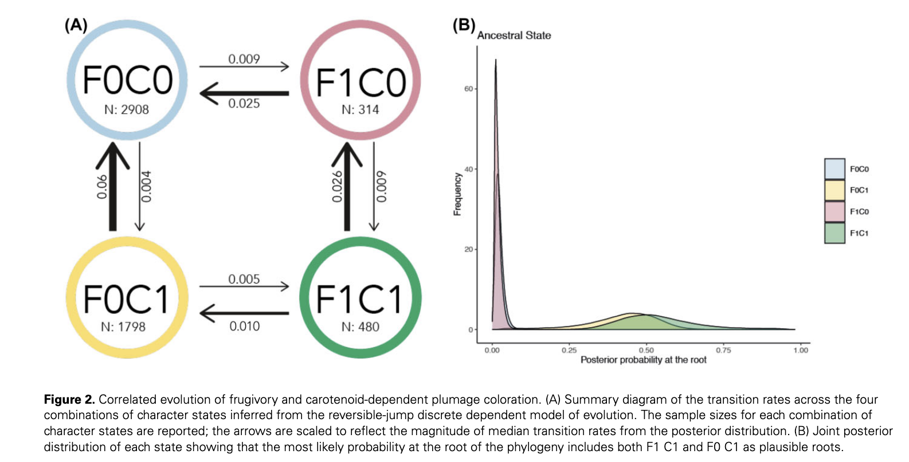
How do frugivory and/or carotenoids evolve with each other and affect diversification?
Test for effect on diversification (*SSE in RevBayes): there are different rates, but not linked to these traits
Ignore diversification, use just BayesTraits
F1: frugivory yes
F0: frugivory no
C1: carotenoids yes
C0: carotenoids no

Slide 28
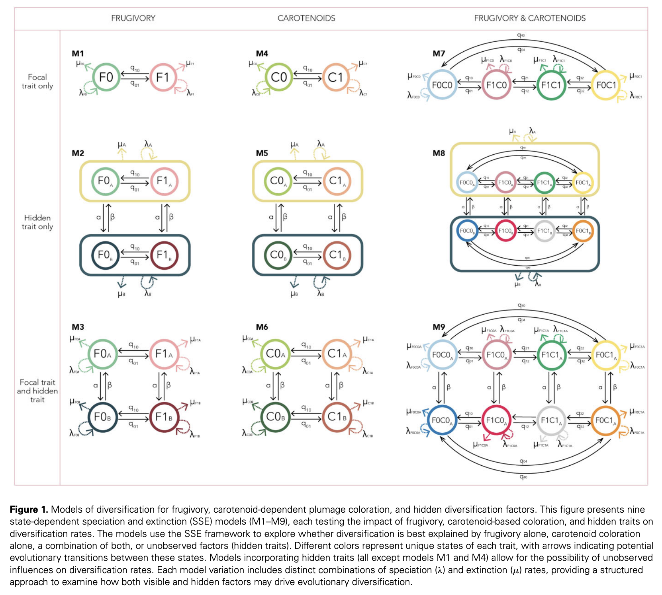

Slide 29
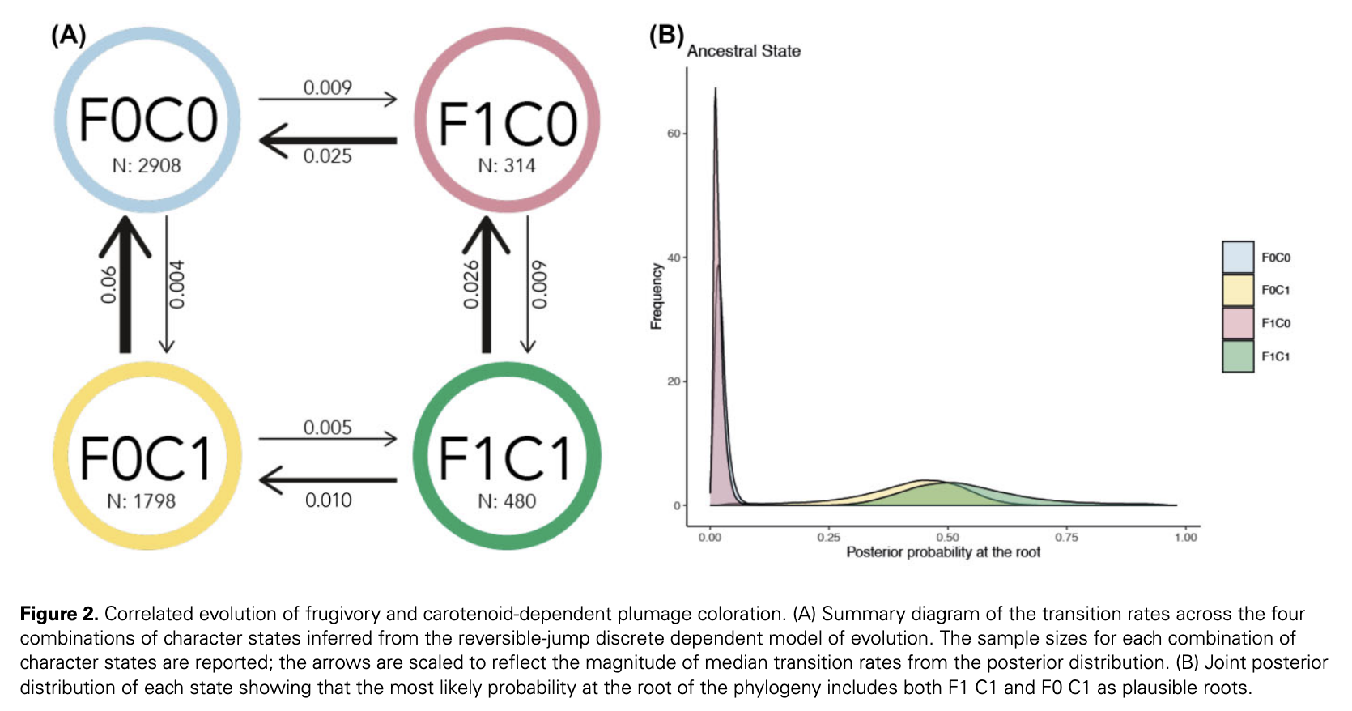

Slide 30
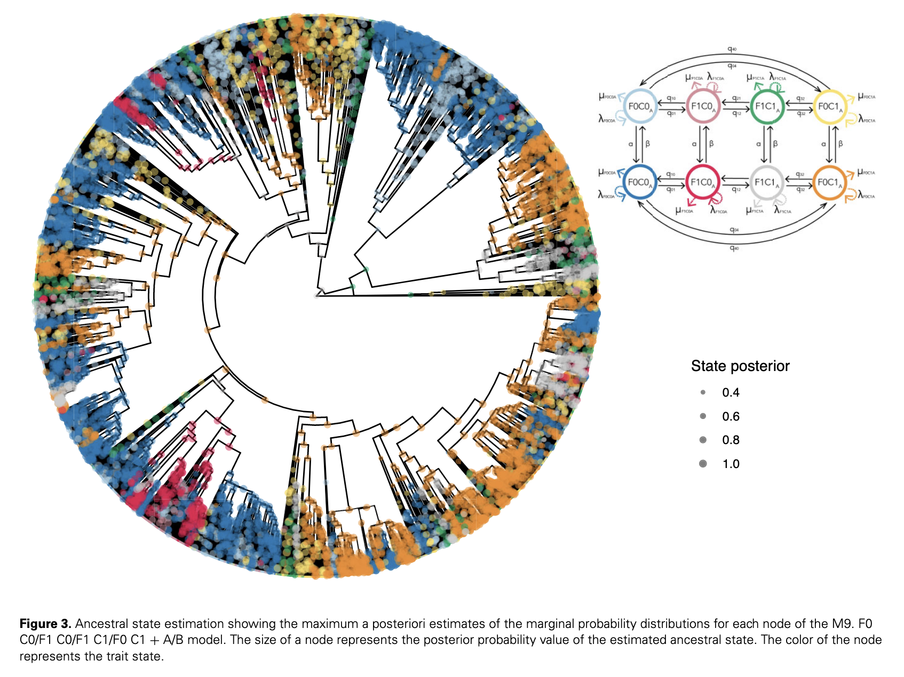

Slide 31
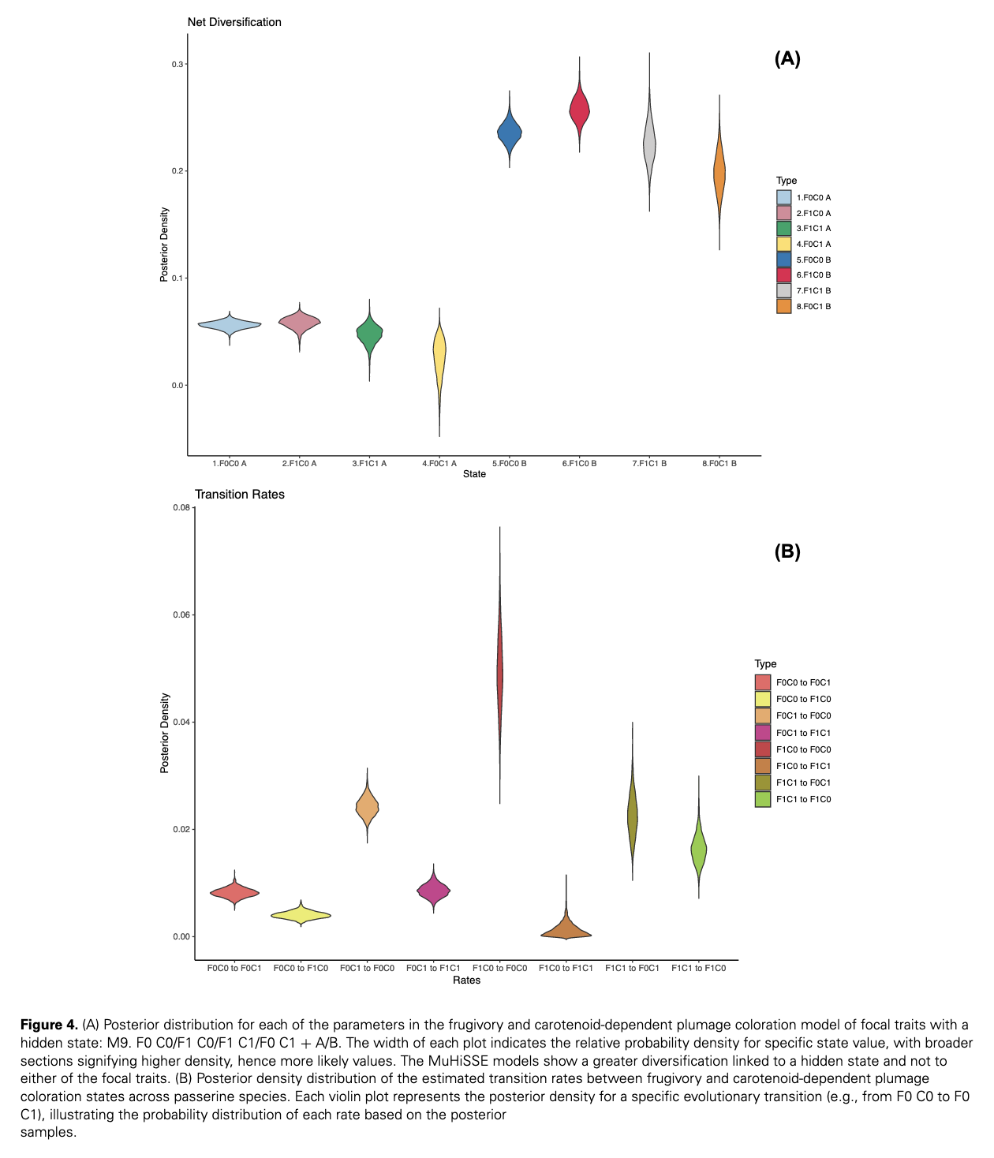

Slide 32
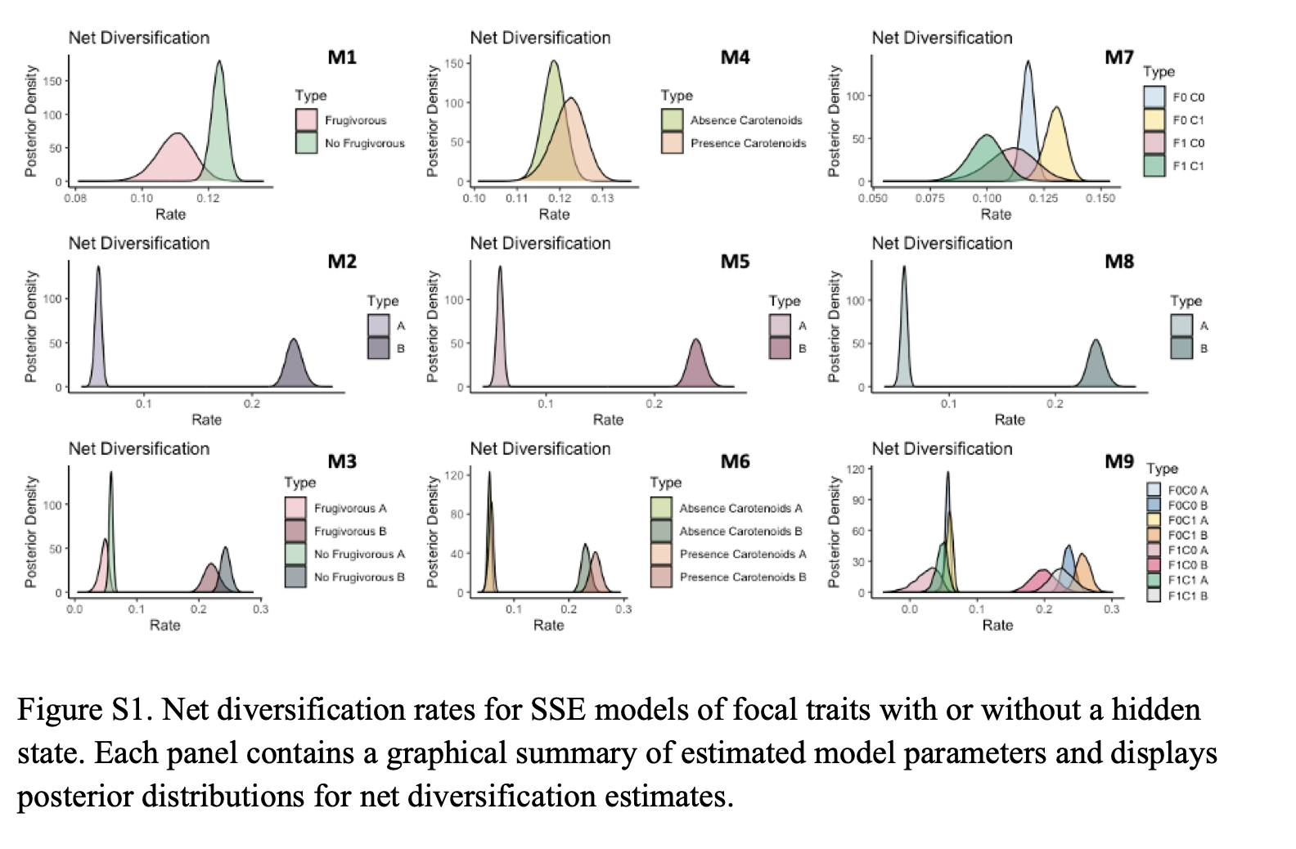

Slide 33
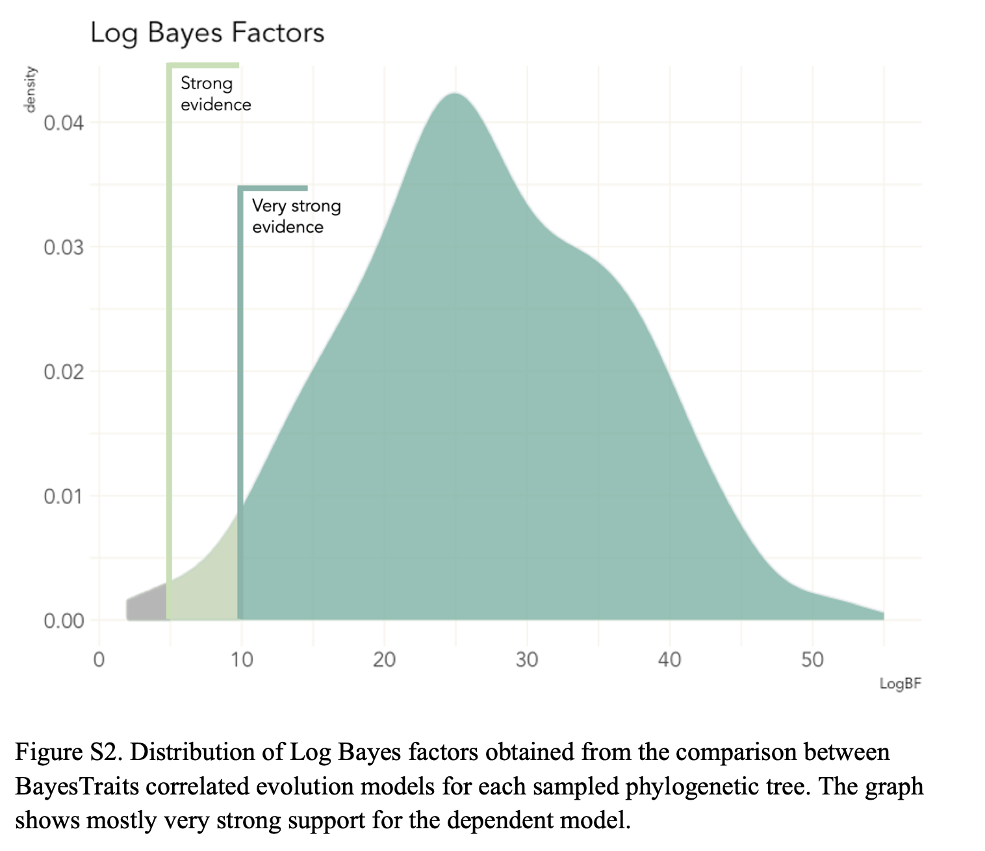

Slide 34
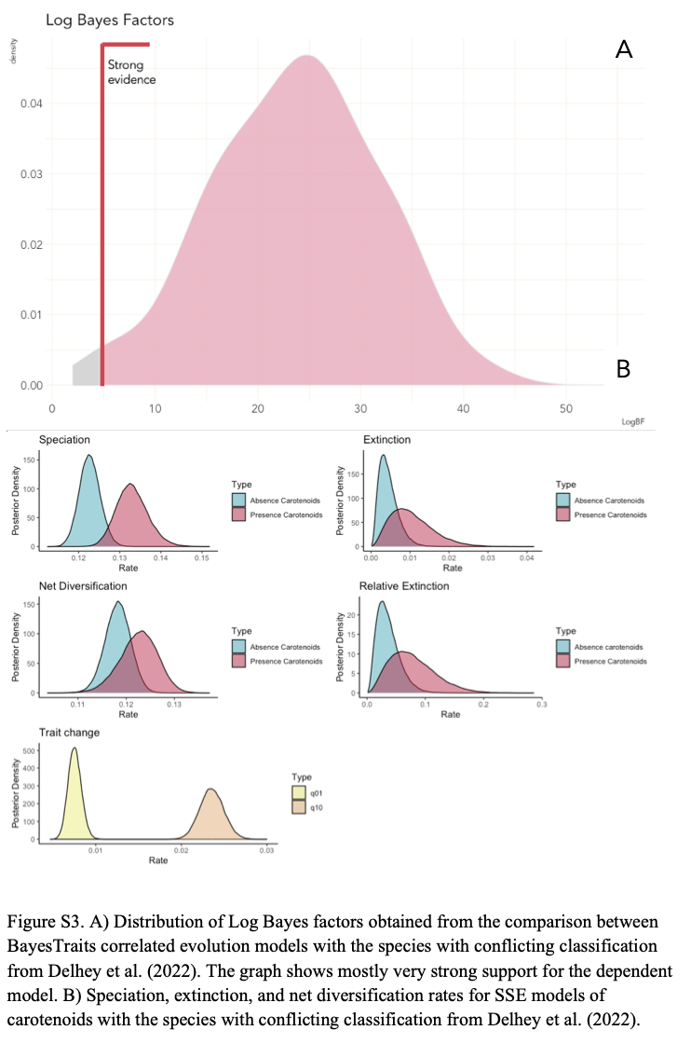

Slide 35
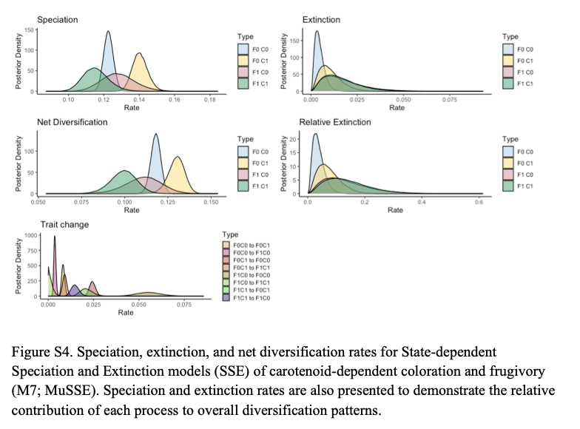

Slide 36
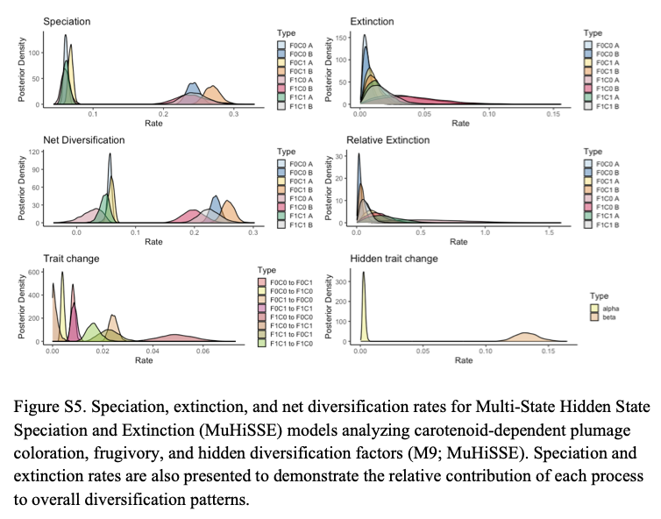

Slide 37
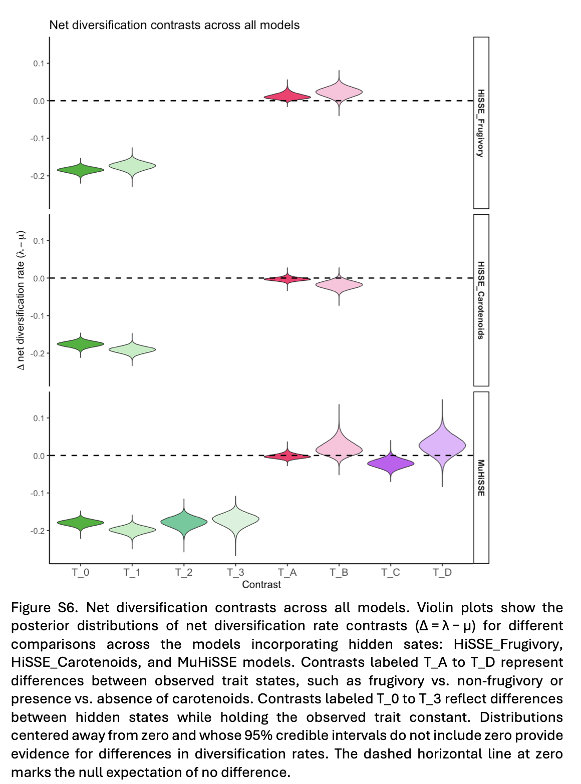

Slide 38
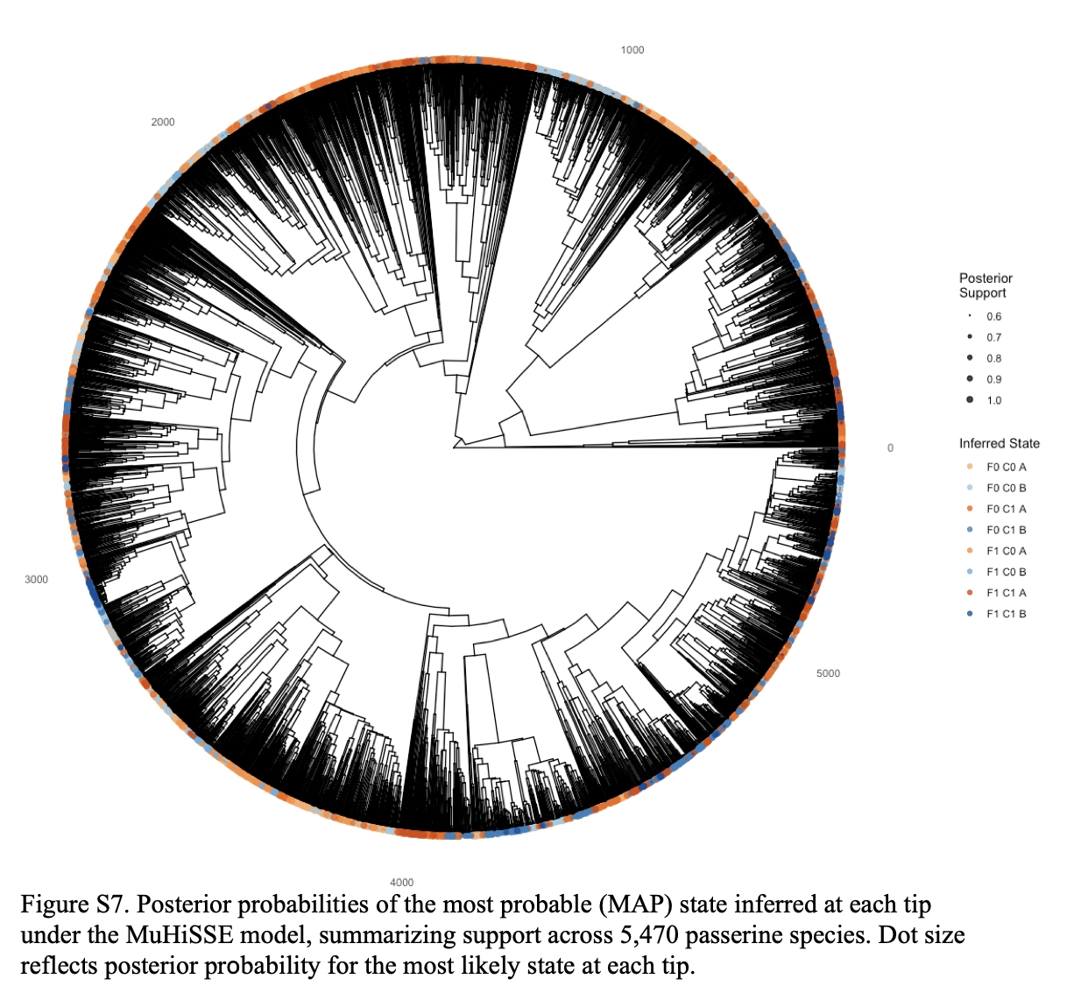

Slide 39
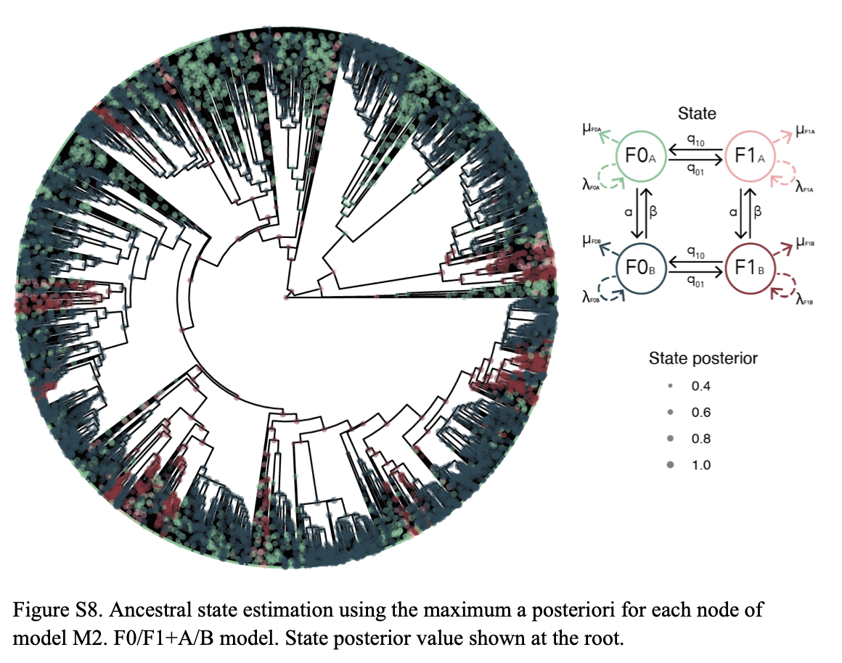

Slide 40
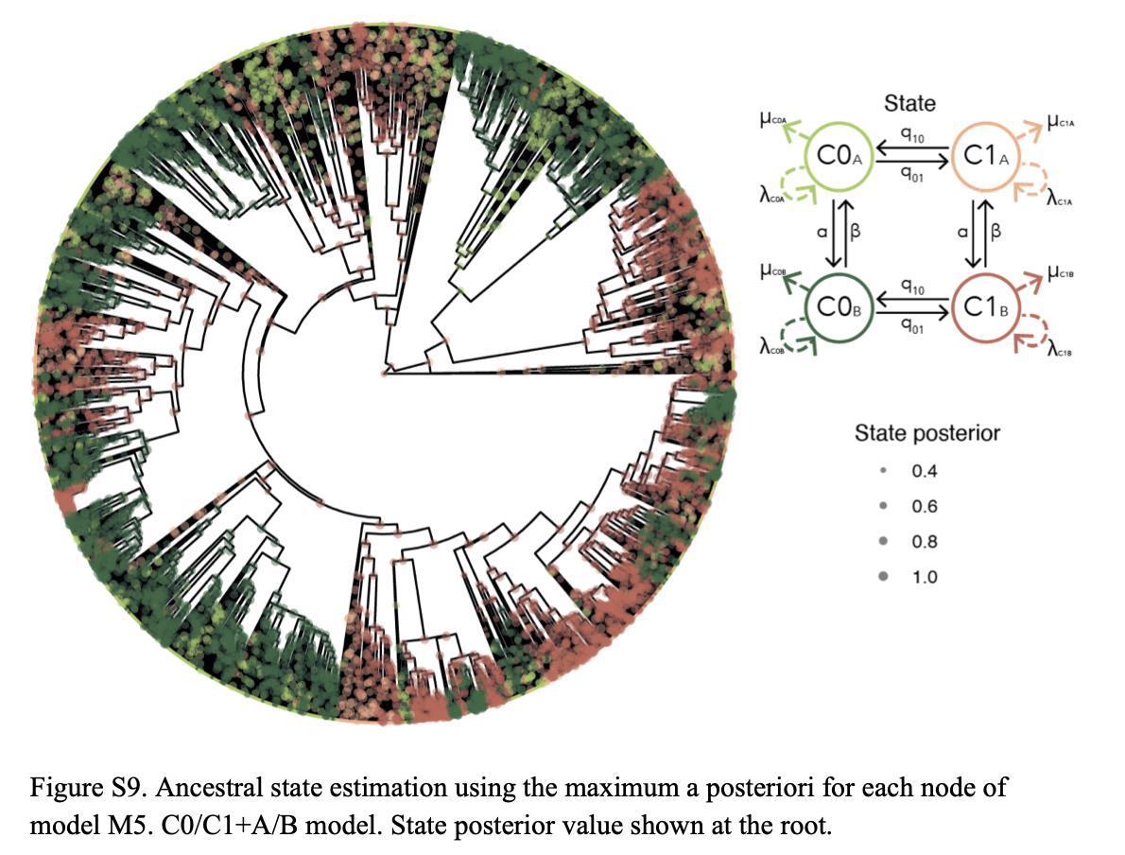

Slide 41
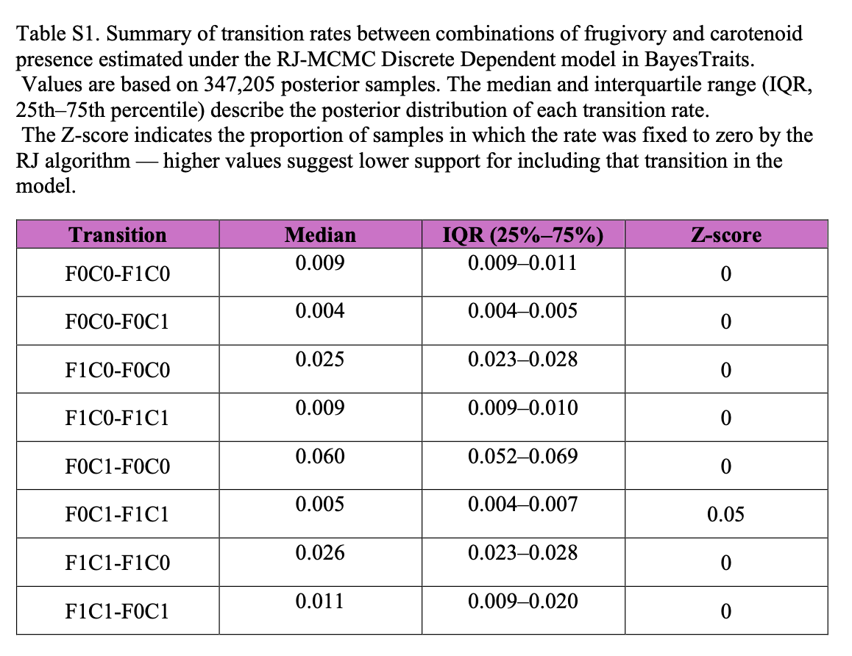

Slide 42
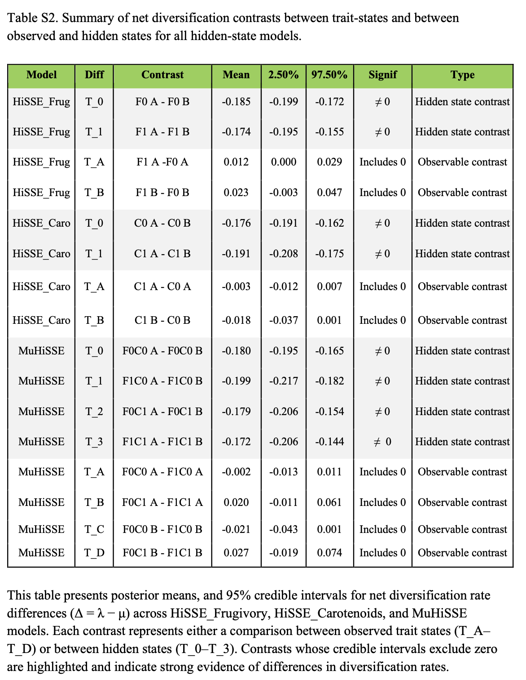

Slide 43
What are Bayes factors?
What is reversible jump MCMC?
Why did they binarize frugivory and coloration. Although they do talk about this in the discussion, I think it would have been more interesting to look at continuous traits. So that makes me think what even the point of the paper was if they made such a categorization. It does give a foundation for further studies. On that note, my question is how do we look at continuous traits without categorization?
In the methods at the top of the right side of page 1645, the authors state that they conservatively classified "species where fruit consumption was mentioned without quantitative detail (e.g., “fruits and insects”) as nonfrugivorous, as these descriptions did not specify the proportion of fruits in their diet." It seems to me that the most conservative option would be to remove these species from the analysis altogether, as they did with species without enough information on diet. Why did they choose to include species without quantative information
."We obtained a distribution of 1,000 trees with different topologies from the pseudo-posterior distribution for the Hackett backbone ( Jetz et al., 2012 ). These trees allowed us to account for phylogenetic uncertainty by sampling across a range of topologies". If that interpretation is right, how common is it to do this?
Is there a specific reason they chose these numbers or do you just want a big enough itteration in the MCMC process? "MCMC chains were run for 1,010,000 iterations for each topology, totaling 505,000,000 iterations, with 10,000 iterations as burn-in and sampling every 1,000 iterations.”
Philosophically, is there a point at which your trees are so big and you have so many traits, does it make sense to plot everything on the tree? Like figure 3 is a choice, it is pretty to look at, but it is hard for me to extract meaningful information from it at the tip
Also, is there a historical reason why birds have so many resources like BirdTree.org, eBird.org, etc? Or do people really just like birds?
Why do we need to incorporate speciation and extinction into the models?

